Slide 1
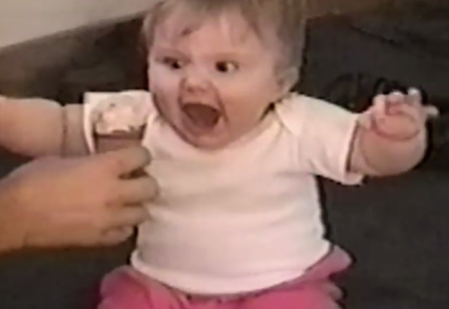
Ice Cream!
Regression Analysis
What are the possible factors that influence ice cream consumption?
Can we predict consumption?

Slide 2
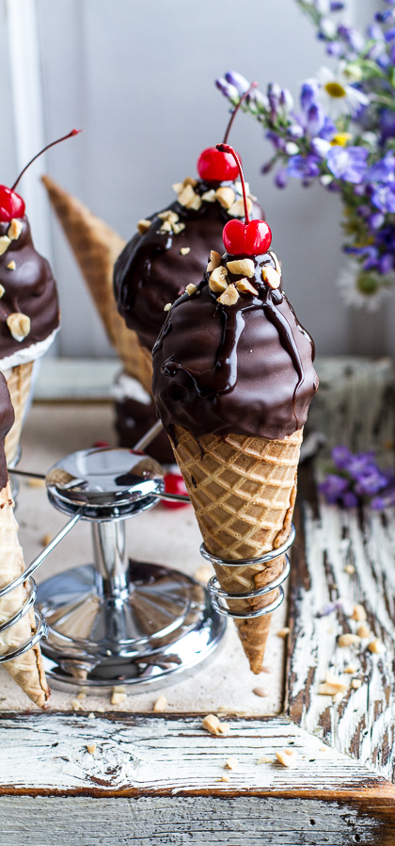
The Data
Ice cream consumption (cons, pints per person) was measured over 30 four-week periods from March 1951 to July 1953.
It is thought that variables influencing consumption may include:
the weekly family income (inc, $)
the mean monthly temperature (temp, °F)
Can you build a model that predicts consumption based on given data?

Slide 3
cons | inc | temp
0.386 | 78 | 41
0.374 | 79 | 56
0.393 | 81 | 63
0.425 | 80 | 68
0.406 | 76 | 69
0.344 | 78 | 65
0.327 | 82 | 61
0.288 | 79 | 47
0.269 | 76 | 32
0.256 | 79 | 24
0.286 | 82 | 28
0.298 | 85 | 26
0.329 | 86 | 32
0.318 | 83 | 40
0.381 | 84 | 55
0.381 | 82 | 63
0.47 | 80 | 72
0.443 | 78 | 72
0.386 | 84 | 67
0.342 | 86 | 60
0.319 | 85 | 44
0.307 | 87 | 40
0.284 | 94 | 32
0.326 | 92 | 27
0.309 | 95 | 28
0.359 | 96 | 33
0.376 | 94 | 41
0.416 | 96 | 52
0.437 | 91 | 64
0.548 | 90 | 71

Slide 4
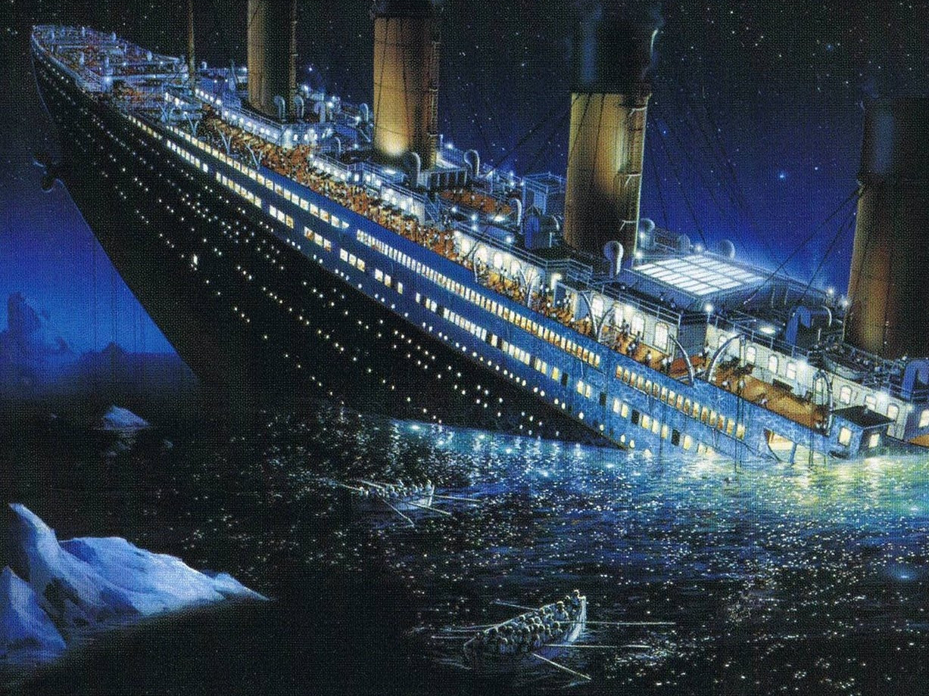
Titanic ML Problem (kaggle)
On April 15, 1912, during her maiden voyage, the Titanic sank after colliding with an iceberg
Killing 1502 out of 2224 passengers and crew
Some groups of people were more likely to survive than others (such as women, children, and the upper-class)
Apply the tools of machine learning to:
Predict which passengers survived the tragedy
Practice Skills
Binary classification
Python and R basics

Slide 5
…see the data …categorical/continuous vars … classification is the objective

Slide 6
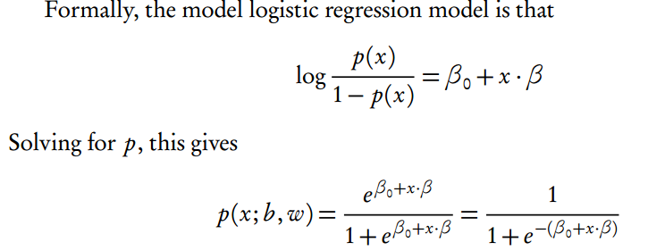
Logistic Regression

